Slide 1
On the Generative Discovery of Structured Medical Knowledge
Advisor: Jia-Ling, Koh
Speaker: Ming-Chieh, Chiang
Source: KDD 2018
Date: 2018/10/23

Slide 2
Outline
Introduction
Method
Experiment
Conclusion

Slide 3
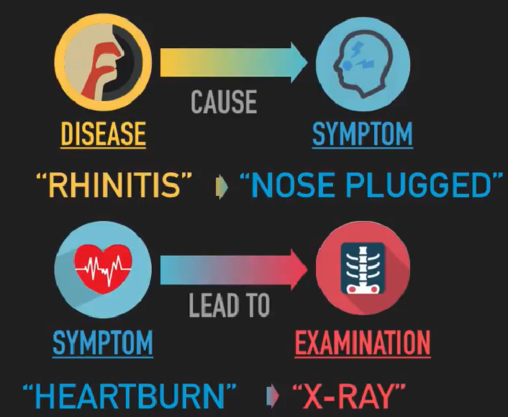
Motivation
Time-consuming
Labor-intensive

Slide 4
Goal
Expanding the scale of high-quality yet novel structured medical knowledge with minimized data requirement
Example

Slide 5
Outline
Introduction
Method
Experiment
Conclusion

Slide 6
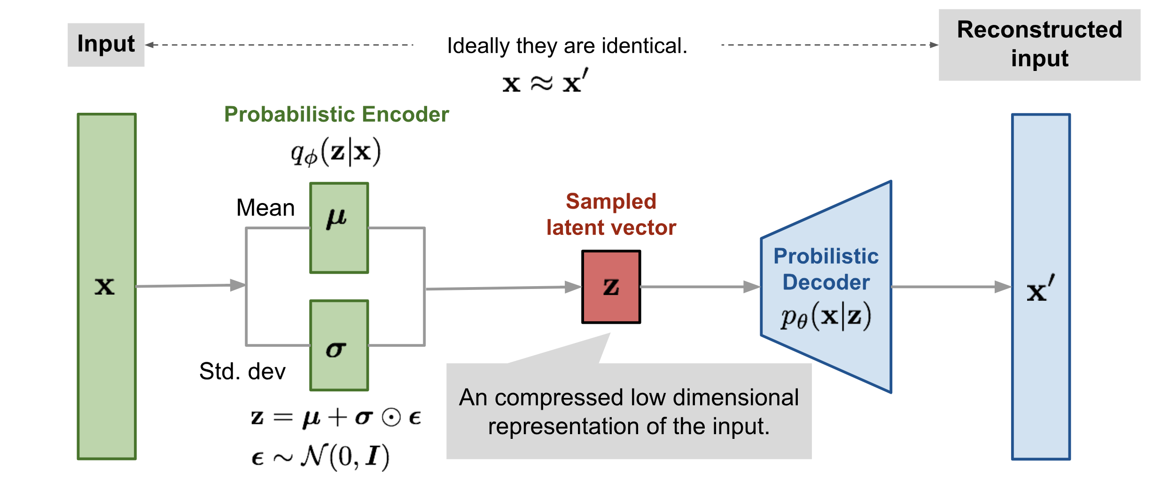
VAE
Variational Autoencoder

Slide 7
CRVAE
Conditional Relationship Variational Autoencoder

Slide 8
Encoder

Slide 9
Decoder

Slide 10
Loss function
VAE
CVAE
CRVAE

Slide 11
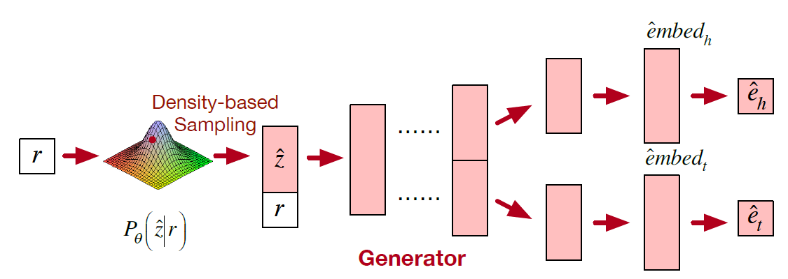
Generator

Slide 12
Outline
Introduction
Method
Experiment
Conclusion

Slide 13
Dataset
46018 real-world relational medical entity pairs
6 types of medical relationships
Training: 0.7 / Validation: 0.3

Slide 14
Evaluation

Slide 15
Baseline
CRVAE-MONO
CRVAE-RAND
CRVAE
CRVAE-WA

Slide 16
Performance

Slide 17
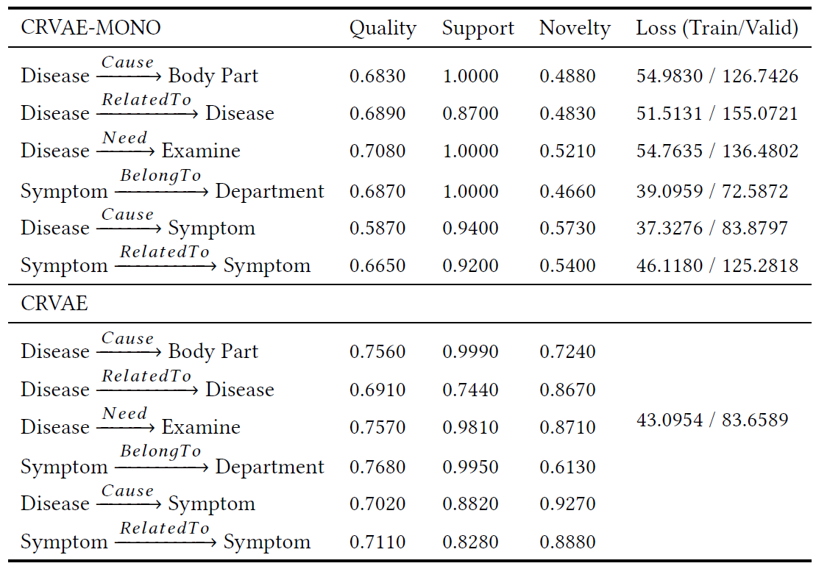
Generative Modeling Capacity

Slide 18
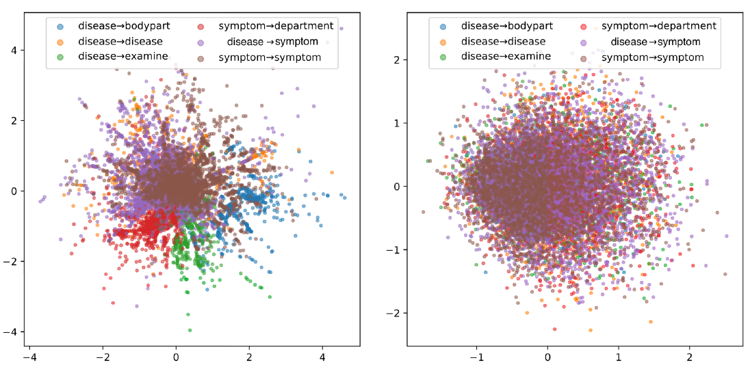
Ability to Infer Conditionally
RVAE CRVAE

Slide 19
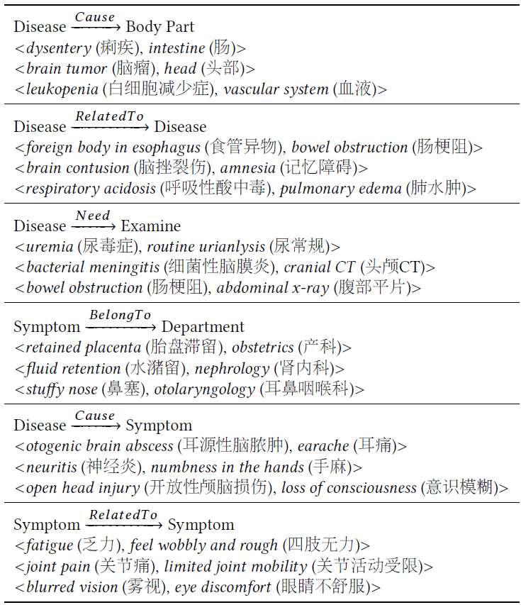
Result

Slide 20
Outline
Introduction
Method
Experiment
Conclusion

Slide 21
Conclusion
We introduce a generative perspective to study the Relational Medical Entity-pair Discovery (REMEDY) problem
CRVAE can generatively discover relational medical entity pairs for a specific relationship

